Slide 1







CUISINE COMPASS
A restaurant recommendation system using sentiment analysis of user reviews
REPORT
LOHITH SRIKANTH PENTAPALLI
RITIKA RADHAKRISHNAN
LISHEL AQUINAS
DAYASAAGAR
RELINA VAS

Slide 2
TABLE OF CONTENTS
1
OVERVIEW
2
FLOWCHART
3
DATA ANALYSIS AND VISUALIZATION
4
SENTIMENT ANALYSIS
5
RECOMMENDATION SYSTEM
6
FUTURE SCOPE

Slide 3
OVERVIEW
Cuisine Compass - A smart restaurant recommendation system that analyzes user reviews using advanced NLP techniques
COMPARATIVE ANALYSIS OF SENTIMENT ANALYSIS MODELS AND A USER-FRIENDLY INTERFACE FOR SEAMLESS INTERACTION
PERSONALIZED RESTAURANT SUGGESTIONS BASED ON SENTIMENT ANALYSIS, TOPIC MODELING, AND RATING AGGREGATION
RECOMMENDATIONS BASED ON FOOD RECOMMENDATIONS EXTRACTED FROM POSITIVE REVIEWS USING NAMED ENTITY RECOGNITION (NER) AND LOCATION-BASED SUGGESTIONS

Slide 4
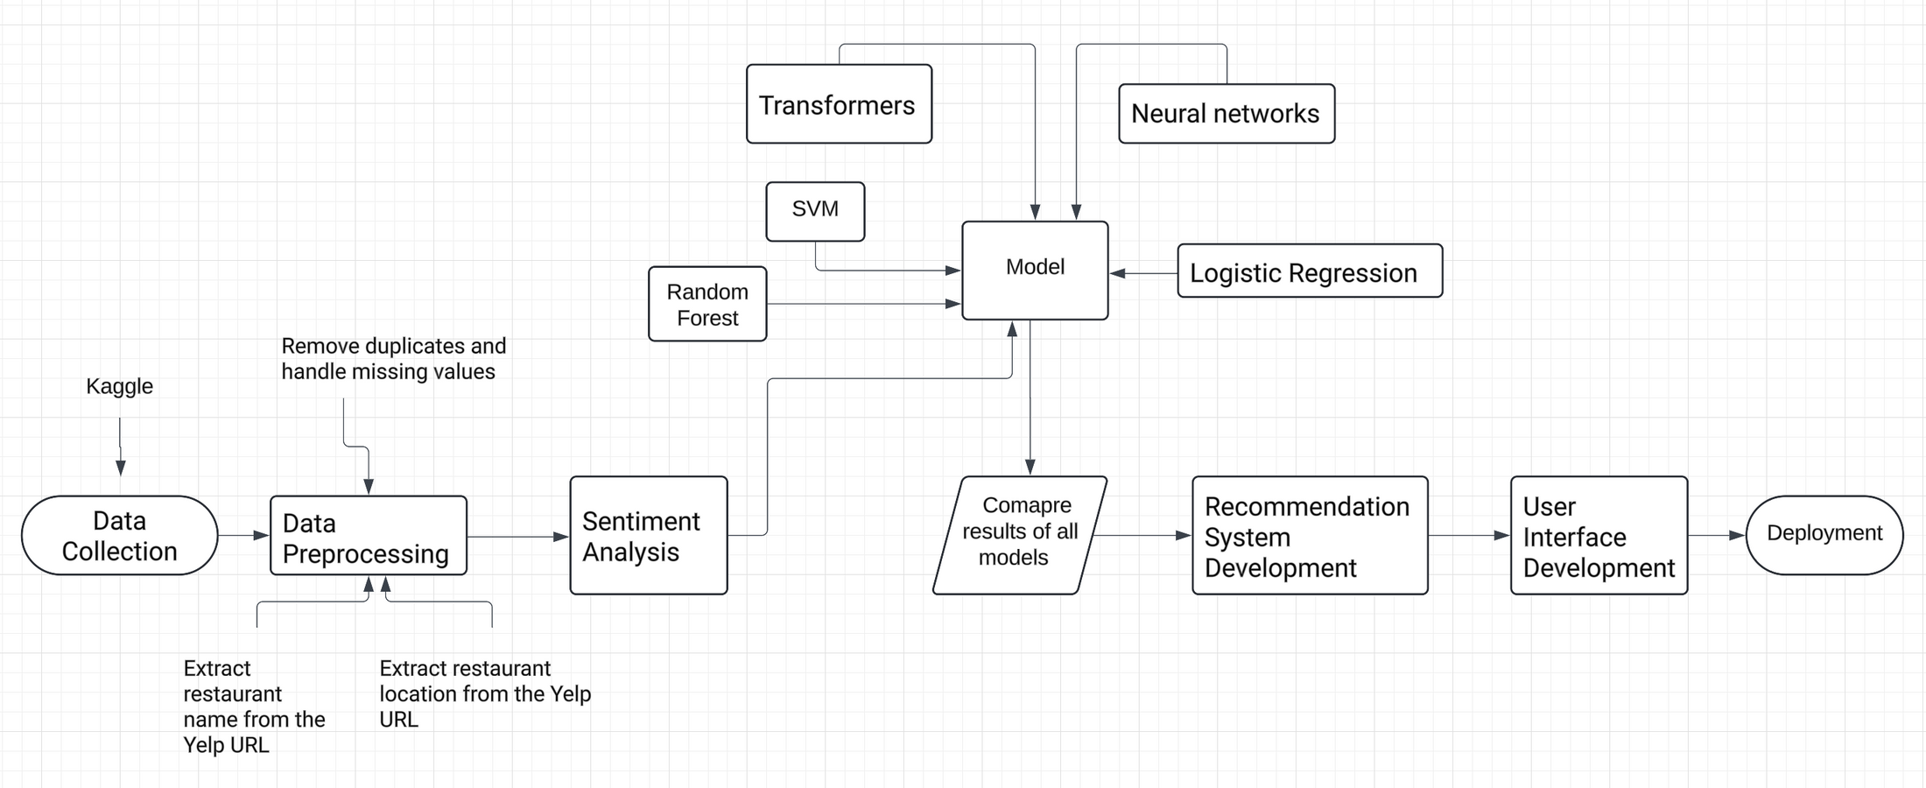
FLOWCHART

Slide 5
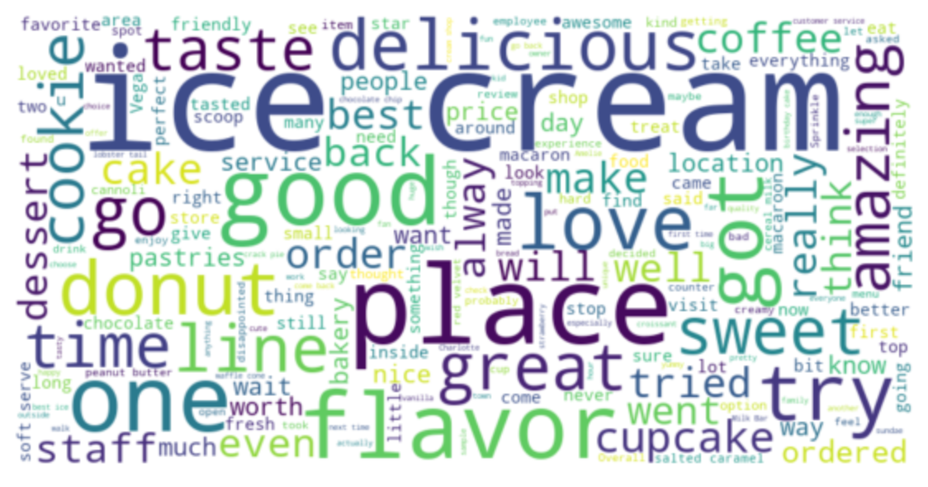
DATA ANALYSIS AND VISUALIZATION

Slide 6
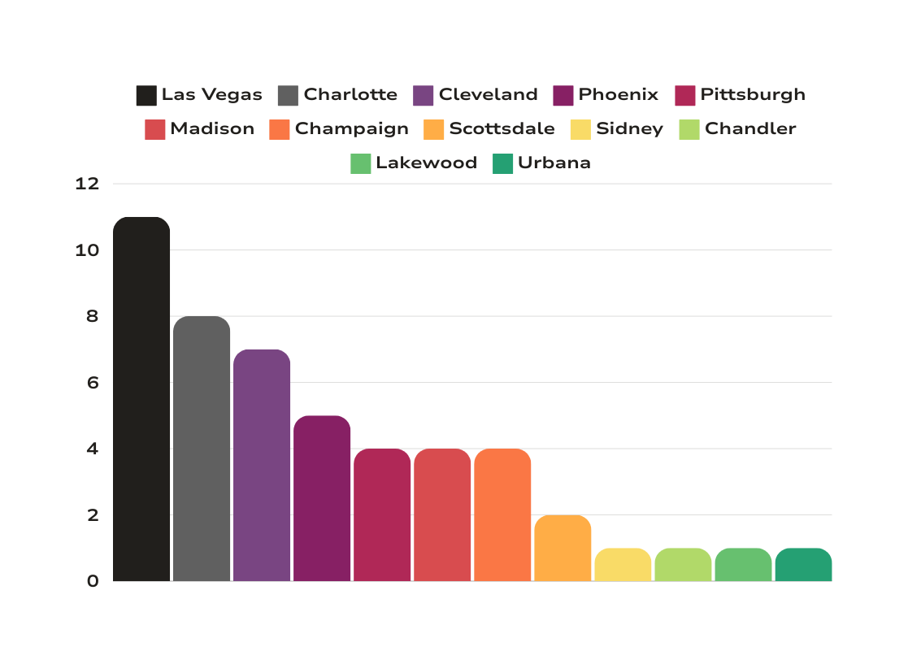
COUNT OF RESTAURANTS IN EACH CITY
11
8
7
5
4
4
4
2
1
1
1
1

Slide 7
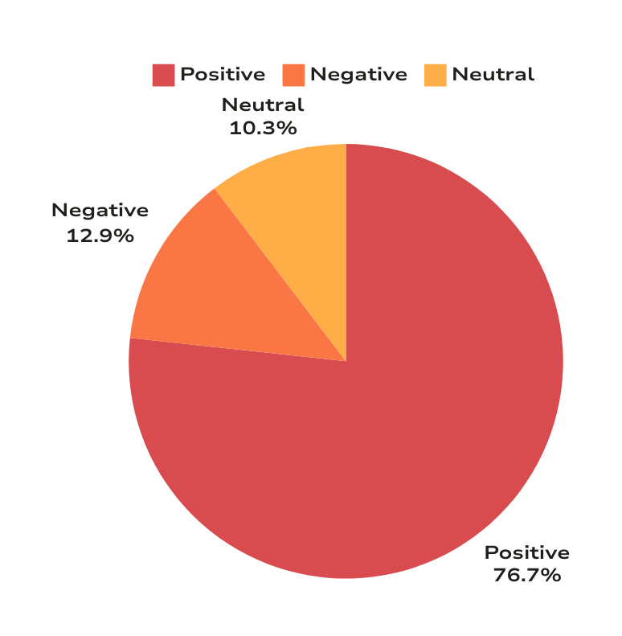
COUNT OF INDIVIDUAL SENTIMENTS

Slide 8
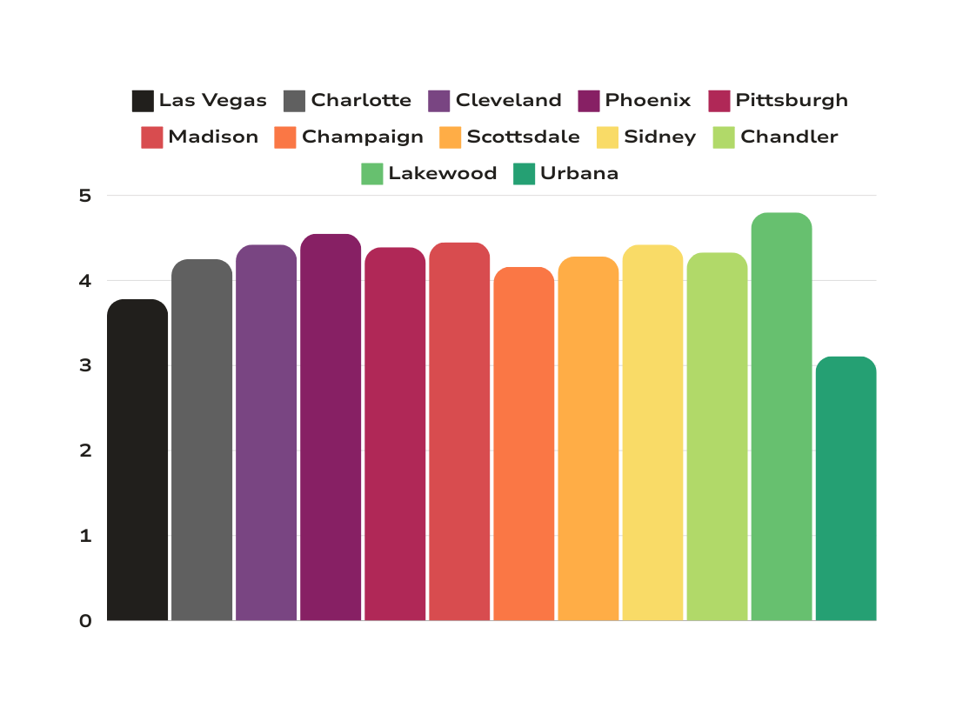
AVERAGE RATING BY LOCATION
4.42
4.25
4.42
4.80
3.78
4.39
4.33
4.45
4.55
4.28
4.16
3.11

Slide 9
EDA
Data preprocessing involved cleaning URLs, extracting location and establishment names, and reordering columns
Numerical ratings were transformed into categorical sentiment labels to aid analysis
Exploratory data analysis (EDA) covered the distribution of ratings across locations
EDA also focused on the frequency of positive, neutral, and negative reviews
Visualizations such as bar plots, word clouds, and sentiment histograms were used to illustrate insights

Slide 10
SENTIMENT ANALYSIS
Transformers: Leverage advanced pre-trained models like BERT that capture the context and nuances of textual data in reviews which led to superior sentiment classification accuracy
Logistic Regression: Straightforward and computationally efficient way to model the probabilities of different sentiment classes based on TF-IDF features
Random Forest: Handle the high dimensionality and sparse nature of TF-IDF vectors from review texts, robustness against overfitting through its ensemble approach
Neural Networks: Ability to learn complex patterns through layers and non-linear transformations, utilize dropout and batch normalization to enhance generalization
SVM (Support Vector Machine): Focus on constructing hyperplanes in a transformed feature space to separate different sentiment classes

Slide 11
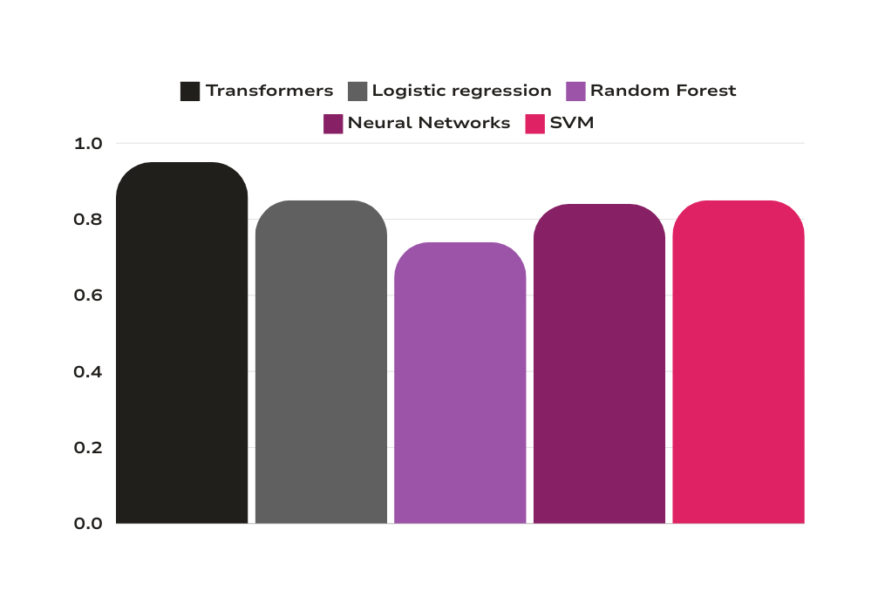
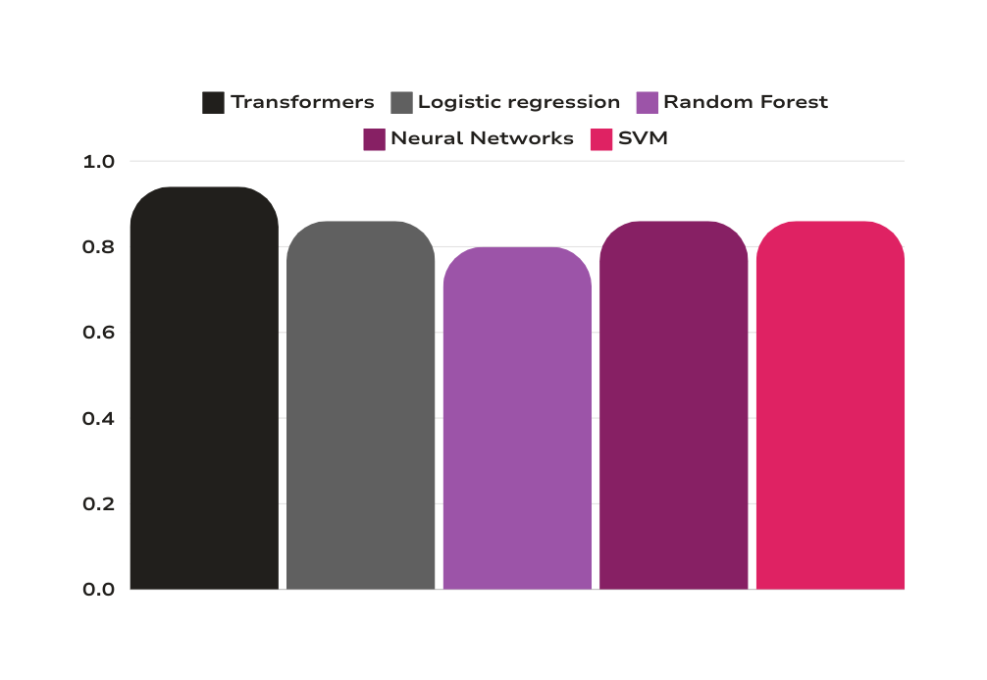
RESULTS
0.89
0.89
0.85
0.84
0.85
0.86
0.86
0.86
0.85
0.74
F1 SCORE BY MODEL
ACCURACY BY MODEL

Slide 12
RECOMMENDATION SYSTEM
The SentimentIntensityAnalyzer from the NLTK Vader module offers a straightforward approach to sentiment analysis in text data
This tool evaluates the intensity of positive, negative, and neutral sentiments, along with an overall compound sentiment score
By assigning polarity scores to individual tokens (words or phrases), it aggregates them to generate an overall sentiment score ranging from -1 to +1
Its versatility allows it to handle informal text found in social media, including slang, emojis, and context-specific expressions
The SentimentIntensityAnalyzer is invaluable for applications such as social media monitoring, customer feedback analysis, and opinion mining

Slide 13
RESULTS
Food Recommendations: Using Named Entity Recognition (NER), curated recommendations for must-try dishes derived from positive reviews
User engagement: Catering to individual tastes and preferences, fostering culinary discovery and enjoyment
Location-Based Recommendations: Recommend nearby dining establishments tailored to their unique preferences and interests using user location data
User Interface: Using Streamlit, an open-source Python library
Display the output that includes the top restaurants in the given location along with some must try dishes from those restaurants
User drop down in the UI will have recommendations that have all restaurants from highest rating to the lowest, must try recommendation in each restaurant, and top 5 reviews for every restaurant

Slide 14
FUTURE SCOPE
Dynamically adjust restaurant suggestions based on the time of day and user preferences, E.g. brunch during weekends and fine dining options for dinner on weekdays
Highly personalized suggestions with integration of user-specific data, such as dietary preferences, past dining experiences, or favorite cuisines
Real-time feedback mechanism to continuously refine and improve its recommendations
Make recommendations relevant and personalized over time

Slide 15
THANK YOU

